Slide 1
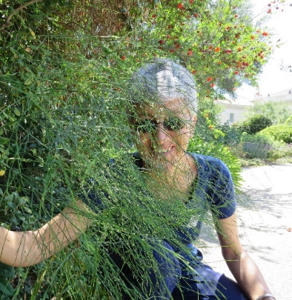
www.enthusiasticlife.net
DrAnneenthusiasticLife
Dr MargiAnne Isaia, MD MPH PCC-T
Parenting Ten Things
11
SET
PART

Slide 2
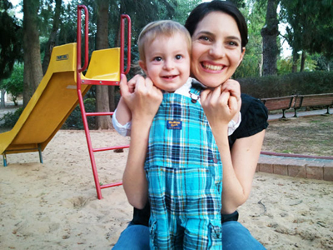
10 THINGS
EVERY CHILD
NEEDS
Brain Development in Infancy
and early Childhood
1 INTERACTION
Relationship between parent and child
Engage the child’s brain through personal interaction, eye-to-eye contact, and gentle care.
North Dakota State University * Bright Beginnings

Slide 3

10 THINGS
EVERY CHILD
NEEDS
Brain Development in Infancy and early Childhood
2 TOUCH
How a child first knows love
Sends signals to the brain to make connections; hugs and kisses; as critical a nutrient as vitamins
North Dakota State University * Bright Beginnings

Slide 4
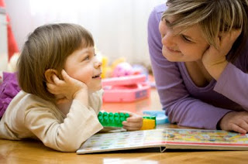
10 THINGS
EVERY CHILD
NEEDS
Brain Development in Infancy and early Childhood
3 STABLE RELATIONSHIP WITH LOVING ADULT
Bond between parent and child
Kids need a loving and trusted adult in their life; a person to depend on
North Dakota State University * Bright Beginnings

Slide 5

10 THINGS
EVERY CHILD
NEEDS
Brain Development in Infancy and early Childhood
4 SAFE AND HEALTHY ENVIRONMENT
Friendly and secure atmosphere; cover outlets; block off stairs; avoid lead poisoning; put dangerous chemicals out of reach
North Dakota State University * Bright Beginnings

Slide 6

10 THINGS
EVERY CHILD
NEEDS
Brain Development in Infancy and early Childhood
5 SELF-ESTEEM
Fundamental to a child’s development and sense of self
Children are little sponges; need to hear that they are great; deserve attention and reassurance
North Dakota State University * Bright Beginnings

Slide 7

10 THINGS
EVERY CHILD
NEEDS
Brain Development in Infancy and early Childhood
6 QUALITY CHILD CARE
Positive and attentive care on a regular basis
Safe, decent nutrition; people who want to love them and spend time with them
North Dakota State University * Bright Beginnings

Slide 8

10 THINGS
EVERY CHILD
NEEDS
Brain Development in Infancy and early Childhood
7 COMMUNICATION
Words, sounds, and contact
By 6 months a baby can duplicate sounds made by an adult; the more words they hear, the more brain connection will develop
North Dakota State University * Bright Beginnings

Slide 9

10 THINGS
EVERY CHILD
NEEDS
Brain Development in Infancy and early Childhood
8 PLAY
Everything is learned through play
Play is linked with mental growth and development; it is a child’s work; important to do with the child
North Dakota State University * Bright Beginnings

Slide 10

10 THINGS
EVERY CHILD
NEEDS
Brain Development in Infancy and early Childhood
9 MUSIC
Rhythm and rhyme
Sing to them, with them, and expose them to good music
North Dakota State University * Bright Beginnings

Slide 11

10 THINGS
EVERY CHILD
NEEDS
Brain Development in Infancy and early Childhood
10 READING
Imagination and creativity and snuggling
The more reading you do with them, the more brain connections develop
North Dakota State University * Bright Beginnings

