Slide 1
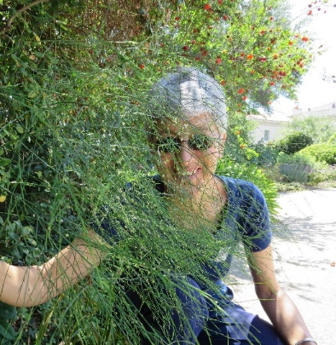
www.enthusiasticlife.net
DrAnneenthusiasticLife
Dr MargiAnne Isaia, MD MPH PCC-T
Family Conflicts
6
SET
PART

Slide 2

FAMILY CONFLICT
Disagreement: the parties involved perceive a threat to their needs, interests or concerns
Conflict is inevitable in relationships, particularly among couples
Some levels of conflict can be beneficial:
- enable couples to communicate in ways that promote understanding
- resolve differences
- foster intimacy
There is potential for couple conflict to escalate beyond a productive level.

Slide 3

FAMILY CONFLICT
‘High conflict’ = when the timing, duration, and intensity of the conflict results in negative effects for the relationship, individual partners, or other family members, most notably children.
Couples that engage in high conflict:
Couples in ongoing stable relationships (conflict-habituated)
Separated or divorced couples.

Slide 4
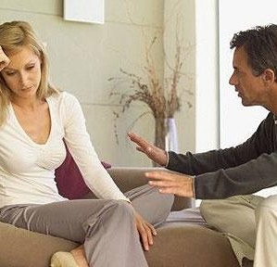
THE CONFLICT
CONTINUUM
- FIVE LEVELS
At each stage of the continuum the ratio of positive to negative, hostile exchanges declines.
Level 1 (Problems to Solve)
Conflict is focused on specific issues and how to solve them. When anger is expressed over differences it is usually short lived and the emotional climate remains hopeful.
Level 2 (Disagreements)
Trust within the emotional environment has begun to fade; partners communicate less often with one another and are more likely to triangulate others into the conflict.
Couples still see ways to address their disagreements.

Slide 5
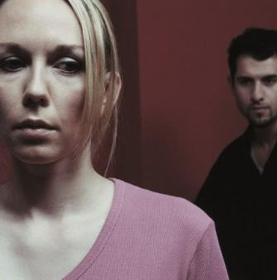
THE CONFLICT
CONTINUUM
- FIVE LEVELS
Level 3 (Contest)
Frustration and resentment, with anger erupting quickly and dissipating slowly.
Each partner generally sees the conflict as coming from the other, such that if the other partner changed, the conflict would disappear.
Level 4 (Fight/Flight)
Increased triangulation of third parties and fixed, negative perceptions of each other.
Antagonism and alienation
Level 5 (War)
Blame, emotional volatility, partners’ inability to take responsibility for their part in the dispute. Hopelessness, rage, and revenge.

Slide 6
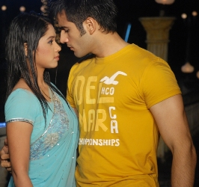
Dr MargiAnne Isaia, MD MPH PCC (T)
www.enthusiasticlife.net
The Battering Cycle
STAGE
WOMAN
MAN
DYNAMICS
1
Honeymoon
phase
Fells special, love, dependent
Jealousy,
over-possessive love, dependency
Lack of mutuality,
lack of healthy intimacy
KRISTI KANEL
A GUIDE TO CRISIS INTERVENTION

Slide 7
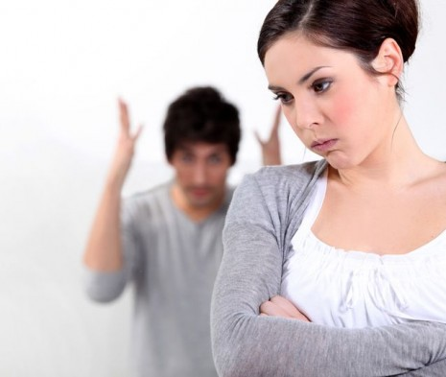
The Battering Cycle
STAGE
WOMAN
MAN
DYNAMICS
2
Tension-building
phase
Walks on eggshells, tries to prevent violence
Minor incidents,
criticizing, yelling,
blaming, may still fell in control of himself,
tension is strong
Woman believes it’s her fault that he’s upset. Both may see that there is a problem. Window of opportunity for preventing next stage through intervention by Counselor.
KRISTI KANEL
A GUIDE TO CRISIS INTERVENTION

Slide 8

The Battering Cycle
STAGE
WOMAN
MAN
DYNAMICS
3
Explosive
phase
If she survives,
often has bruises and broken bones, may end up in a hospital.
Focus on survival versus escape.
Out of control, may terrorize wife for hours, break things, hit, spit,
push, choke, burn,
tie up, rape,
or kick her.
Violence gets worse over time, sometimes police is called.
Window of opportunity exists for woman
before denial sets in.
KRISTI KANEL
A GUIDE TO CRISIS INTERVENTION

Slide 9
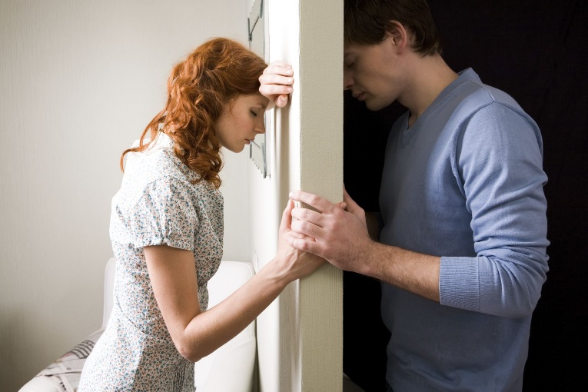
The Battering Cycle
STAGE
WOMAN
MAN
DYNAMICS
4
Honeymoon stage again
In shock, vulnerable to accepting apologies and flowers, hopes it won’t happen again.
Apologizes, swears it will never happen again, encourages her to go shopping, throw a party, treats her well for a while.
False resolution based on denial and minimization, life goes on. Tension reoccurs and the cycle continues. Honeymoon is the first stage to go until eventually, it consists of just tension-explosion.
KRISTI KANEL
A GUIDE TO CRISIS INTERVENTION

Slide 10

CHARACTERISTICS
OF CONFLICT
THAT CAN BE
DESTRUCTIVE
TO COUPLES:
Criticism, contempt, defensiveness, stonewalling
Elements of the four characteristics help elucidate what differentiates low-level conflict from destructive high-level conflict
Criticism, distinct from complaints, such that when couples criticize each other; their interaction is directed at the person rather than the disputed issue or situation
Contempt, marked by an environment of cynicism, sarcasm and disgust that is fueled by “long-simmering negative thoughts about” one’s partner.

Slide 11
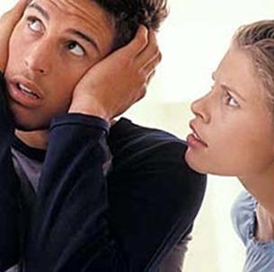
CHARACTERISTICS
OF CONFLICT
THAT CAN BE
DESTRUCTIVE
TO COUPLES:
Defensiveness, a way to blame one’s partner or defend self
Stonewalling, when criticism, contempt and defensiveness reach a level that one partner tunes out
Conflict effects for the partners:
- Chronic physiological arousal
- Negative perceptions, including negative attributions/sentiments about one’s partner and the relationship
- Failure of partners to accept influence from each other or to attempt to repair the relationship.

Slide 12
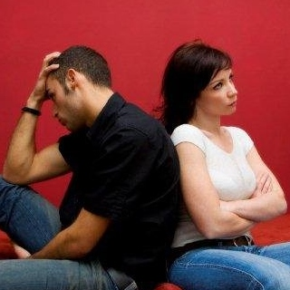
VIOLENCE
IN HIGH CONFLICT
RELATIONSHIPS
Violence and aggression are common among couples in the general population.
The prevalence of violence in high conflict couples is even greater
Many of the characteristics associated with high conflict such as anger, jealousy, poor marital adjustment, lack of conflict resolution, and negative attributions are frequently cited as being correlated with relational violence.

Slide 13
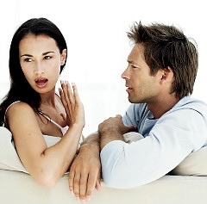
VIOLENCE
IN HIGH CONFLICT
RELATIONSHIPS
Patriarchal terrorism
Severe violence and abuse - Tactics of control, domination, fear, manipulation, and degradation directed toward the partner
Violence in these couples is a one-sided affair perpetrated by a batterer against a victim.
In contrast, the violence among high conflict couples is more aptly.
Situational couple violence
Violence in these couples - frequently mutual and lacks the degree of control, manipulation, and degradation characteristic of battering relationships (mutual escalation).

Slide 14
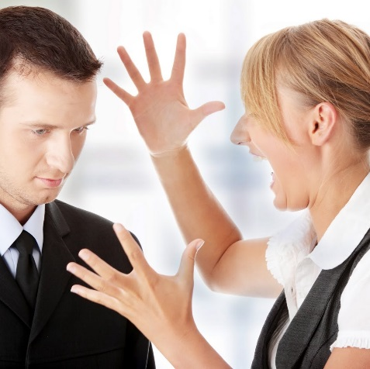
DEFINITION
OF HIGH CONFLICT
COUPLE
RELATIONSHIPS
CLUSTER I: PERVASIVE NEGATIVE EXCHANGES
Pervasiveness
An obvious but essential feature of high conflict dyads is that their interactions are dominated by conflict. For these pairs, pervasiveness involves rapid escalation of conflict that intrudes into communication
Although couples experiencing conflict for a relatively short period of time may escalate into high conflict, a defining feature of high conflict couples is that the conflict persists across time.
Part of what keeps high conflict couples entrenched in conflict is failure to reach resolution or compromise.

Slide 15
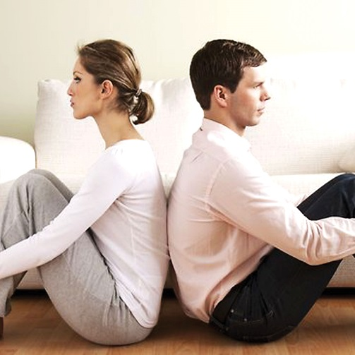
DEFINITION
OF HIGH CONFLICT
COUPLE
RELATIONSHIPS
CLUSTER I: PERVASIVE NEGATIVE EXCHANGES
Defensiveness
Self-protection, avoidance, withdrawal, stonewalling, or efforts to control the other before being controlled.
Reduced opportunity for trust to develop among high conflict couples, attempts at mediation difficult.
Aggression
Attacks that are person-focused rather than issue-focused and that may appear offensive and unprovoked. Aggression may be in the form of either verbal or physical attacks.

Slide 16
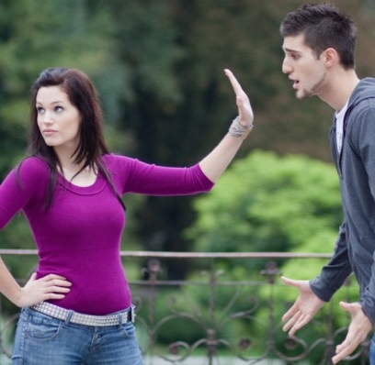
DEFINITION
OF HIGH CONFLICT
COUPLE
RELATIONSHIPS
CLUSTER I: PERVASIVE NEGATIVE EXCHANGES
Escalation
Blame, criticism, lack of empathy, emotional reactivity, and a cycle of attack and counterattack
The stronger the anger and fear in the couple relationship, the greater the likelihood of moving from family-only violence to pathological battering

Slide 17
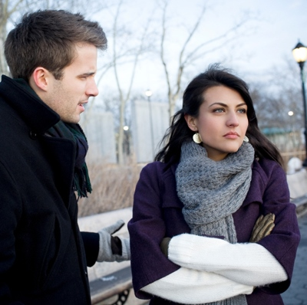
DEFINITION
OF HIGH CONFLICT
COUPLE
RELATIONSHIPS
CLUSTER I: PERVASIVE NEGATIVE EXCHANGES
Negative Attributions and Dualistic Thinking
Negative attributions about the other person, tending toward dualistic thinking that vilifies the other and portrays the self as victim or under attack
Over time, these attributions become rigid, redundant, easily activated, and difficult to extinguish.
Dualistic thinking (e.g., black and white, good or bad, and all or nothing)

Slide 18
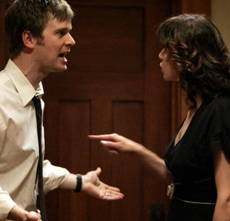
DEFINITION
OF HIGH CONFLICT
COUPLE
RELATIONSHIPS
CLUSTER II: HOSTILE, INSECURE EMOTIONAL ENVIRONMENT
Strong Negative Affect
High levels of anger, hostility, and unresolved conflicts, covertly or overtly expressed, depression and anxiety that may limit parents’ abilities to be nurturing and responsive to their children
Parents often have minimal understanding of the effects of their mutual negative effect on their children
Emotional Reactivity
Both partners in these couples are highly emotionally reactive and tend to vilify each other, low differentiation and an inability to take responsibility for their role in the conflict

Slide 19

DEFINITION
OF HIGH CONFLICT
COUPLE
RELATIONSHIPS
CLUSTER II: HOSTILE, INSECURE EMOTIONAL ENVIRONMENT
Lack of Safety
Emotional insecurity for children: the relationship between the child and one or both parents can become distant, cut-off or alienated.
Mutual Distrust
Disbelief that the partner will ever change, distrust of the other’s capacity to properly care for the children or to have the children’s best interests in mind.

Slide 20
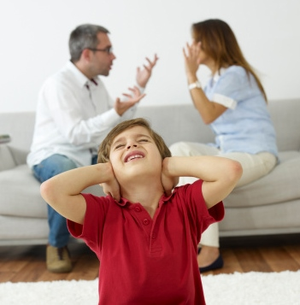
DEFINITION
OF HIGH CONFLICT
COUPLE
RELATIONSHIPS
CLUSTER II: HOSTILE, INSECURE EMOTIONAL ENVIRONMENT
Triangulation
Occurs when tension or conflict builds to an intolerable level within a two-person relationship
To relieve anxiety the person most uncomfortable with the relationship brings a third person into
the relationship (complaining to him/her, gossiping about the other, or asking for advice)
Triangulation becomes dysfunctional when it is a primary strategy for managing conflict, because conflict remains unresolved.
Children are prime targets of the triangulation process.

Slide 21
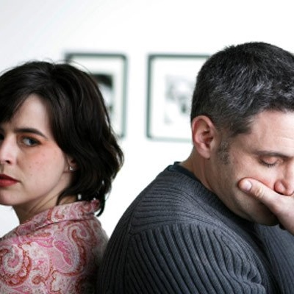
DEFINITION
OF HIGH CONFLICT
COUPLE
RELATIONSHIPS
CLUSTER II: HOSTILE, INSECURE EMOTIONAL ENVIRONMENT
Triangulation
Partners may attempt to gain control over the other by placing the child in the middle and attempting to sway his or her opinion of the other parent, putting pressure on the children to take sides or play the role of messenger or spy.
Parental Alienation Syndrome (PAS)
Triangulation among divorcing couples, one parent vilifying the other parent with unwarranted claims of abuse, neglect, or wrongdoing
Devastating to children, damages to the functioning and reasoning of the adult perpetrator.

Slide 22

OTHER CORRELATES
AND RISK FACTORS
FOR
HIGH CONFLICT
COUPLE RELATIONSHIP HISTORY
Grievances have been present in the relationship and remained unresolved over a period of time.
Sometimes, from the very beginning of the relationship, “perpetual problems”.
Heavily loaded with negative affect, can escalate quickly into full-blown arguments, and have limited strategies for de-escalating or softening the interaction.

Slide 23

OTHER CORRELATES
AND RISK FACTORS
FOR
HIGH CONFLICT
PARTNERS’ INDIVIDUAL HISTORIES AND FAMILY OF ORIGIN EXPERIENCES
Childhood experiences (trauma, abuse, neglect, loss, separation, and related attachment injuries):
- Inability to establish trust, form secure attachments, or manage the stresses inherent in an intimate relationship;
- Seeing the world and relationships as dangerous and uncertain;
They are at high risk for getting stuck in the pervasive kinds of pursue-withdraw or criticize-defend interaction cycles that characterize highly distressed relationships.
Absent capacity to self-soothe and a willingness to accept influence or relationship repair overtures from the partner.

Slide 24

CONFLICT STYLES
AND RELATIONAL
OUTCOMES
Functional (regulated) conflict style = varying degrees of positive relational outcomes.
Distinguished by the degree of willingness of the partners to influence each other through positive dialogue and interaction:
Avoidant, preference to minimize or even avoid conflict with the hope that the issue at hand will resolve (or at least minimize) itself over time, or the couples may simply agree to disagree on the issue without pressing for a resolution.

Slide 25

CONFLICT STYLES
AND RELATIONAL
OUTCOMES
Validating, strive to ensure that each party feels heard and appreciated and work toward mutually satisfactory outcomes
Volatile, engage in active and even passionate disagreement
Research indicates that couples who are matched (both partners utilizing the same conflict styles) and who utilize a more validating style tend to be more relationally satisfied

Slide 26
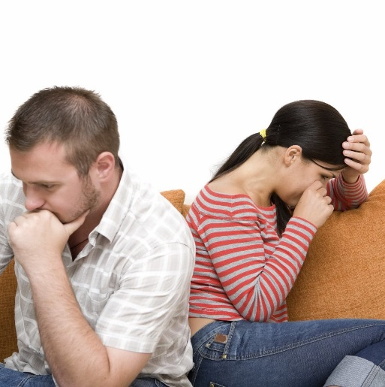
CONFLICT STYLES
AND RELATIONAL
OUTCOMES
Dysfunctional (unregulated) conflict style= destructive outcomes
Hostile, destructive and marked by couples engaging in contemptuous and deprecatory conflict, reducing positive affect and relational stability between the partners
Studies indicate that any couple in which even one partner is hostile is likely to be more problematic and less stable than those in which both partners manifest one of the regulated forms of conflict styles
The validating style is constructive
The avoiding, volatile, and hostile styles are less constructive.

Slide 27

CONFLICT STYLE
AND ADULT
ATTACHMENT
Higher levels of perceived enmeshment and disengagement in families-of-origin will be associated with higher use of hostile, volatile and avoiding conflict styles and lower use of validating conflict style.
Attachment levels will moderate the relationship between perceived enmeshment and disengagement in families-of-origin and conflict styles.

Slide 28

CONFLICT
RESOLUTION
Techniques involved in facilitating the peaceful ending of social conflict
Accept conflict as inevitable
Give priority to your relationship
Seek to understand the other’s perspective
Separate the other’s intention from behavior
Take responsibility for sharing your thoughts and feelings
Take risk to share thoughts and feelings
Practice creating a health home environment
Value yourself even when others don’t
Manage your anxiety and reactivity

Slide 29

BIBLICAL
GUIDELINES
ON
COMMUNICATION
AND CONFLICT
“Death and life are in the power of the tongue.” Proverbs 18:21
“Wherefore my beloved brethren, let every men be swift to hear,
slow to speak, slow to wrath…” James 1:19
“He that keeps his mouth, keep his life; but he that opens
wide his lips shall have destruction..” Proverbs 21:23
“A soft answer turns away wrath, but grievous
words stir up anger…” Proverbs 15:1
“Let your speech be always with grace, seasoned with salt, that you may know how to answer every man.” Colossians 4:6
“Let no corrupt communication proceed out of your mouth,
but what is good to the use of edifying, that it may minister
grace unto the hearers…” Ephesians 4:29

Slide 30

FAMILY
REFLECTION
What were the main reasons for conflict in your family?
What techniques did your parents used to solve their conflicts?
How your family-of-origin influenced your style of dealing with conflict?
What is your style of expressing the unpleasant situations you are involved in?
What can you do beginning today to make a difference in the way you handle conflict in your marriage or family relationships?
How can you help when you are asked to mediate in a family conflict?
What can you do to help a child who is a target in a triangulation process?

Slide 31
REFERENCES
BAPTIST, J.A., THOMPSON, D. E., NORTON, A.M., HARDY, N.R., & LINK, C.D., The effects of the Intergenerational Transmission of Family Emotional Processes on Conflict Styles: The Moderating Role of Attachment The American Journal of Family Therapy, 40:56–73, 2012
ANDERSON, S. R., ANDERSON, S. A., PALMER, K.L., MUTCHLER, M.S.,BAKER, L.K., Defining High Conflict, The American Journal of Family Therapy, 39:11–27, 2011

