Slide 1
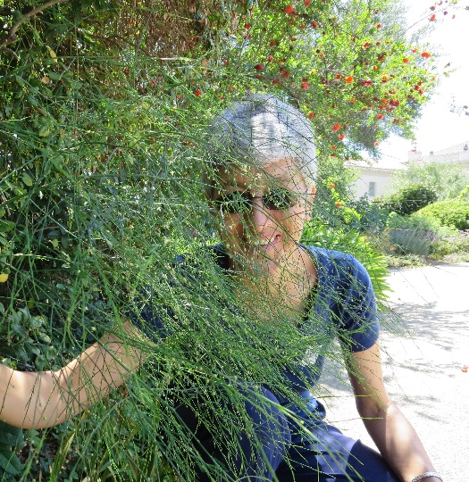
www.enthusiasticlife.net
DrAnneenthusiasticLife
Dr MargiAnne Isaia, MD MPH PCC-T
Sexuality in marriage
7
SET
PART

Slide 2

Love Lab
www.enthusiasticlife.net
“Differentiation includes four dimensions: heroism, generosity, spirituality, and lack of shame”.
“Human differentiation is based on intentionality or self-determination”.
“When intentionality rules our life it brings freedom”.
“Without freedom, commitment and marriage lose their meaning”.
David Schnarch, PhD “Passionate Marriage”, 2009
CONCEPTS

Slide 3
Love Lab
www.enthusiasticlife.net
“Humans are expanding in four dimensions: self-preservation, self-adaptation, self-transcendence and self-dissolution” (Wilber’s framework).
“Intentionality and free will are central ingredients when your desire is conscientiously undertaken and freely chosen”.
“Like the desire for wisdom, the desire for your partner doesn’t disappear once you’ve been satiated”.
David Schnarch, PhD “Passionate Marriage”, 2009
CONCEPTS

Slide 4
Love Lab
www.enthusiasticlife.net
“The desire for your partner grows with time”.
“Sin is our refusal to desire and grow.
Sin is our refusal to believe in ourselves, and our willingness to live below our potential”.
”A wonderful marriage doesn’t make life easy or painless. It just makes the work sweeter and the pain more meaningful”.
David Schnarch, PhD “Passionate Marriage”, 2009
CONCEPTS

Slide 5

Love Lab
www.enthusiasticlife.net
REACTIONS
There is an extraordinary lesson about human relationships that physically fused twins teach.
It helps me have a balanced view of the biblical statement: “the two persons will become one”.
Being intentional or self-determined in every day events makes the partners decide to use their free will and actively participate in their lives. It takes heroism to say “no” in the face of pressure from significant ones.

Slide 6

Love Lab
www.enthusiasticlife.net
REACTIONS
Heroism leads you to self-preservation and development of your identity as a unique person, with no replica, able to function as individual.
It takes generosity to sacrifice your goals in the service of your partner.
Generosity leads to self-adaptation and development of your relational self, making you able to increase the capacity to communicate and function as a part of a larger whole.

Slide 7
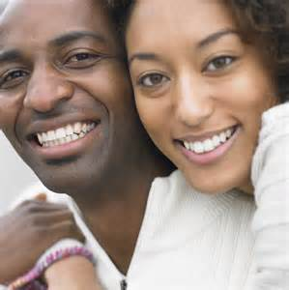
Love Lab
www.enthusiasticlife.net
REACTIONS
It takes spirituality to transcend ourselves and see the unseen, the higher order in Universe.
Spirituality leads to self-transcendence and development of a connection with God that brings you peace, joy, and the sense of belonging to Him.
When spirituality is the main fabric of life’s events partners live in a heavenly atmosphere and their influence impacts others.

Slide 8

Love Lab
www.enthusiasticlife.net
REACTIONS
It takes lack of shame to accept yourself, to confess what you did wrong and reestablish the connection in order to move to a higher level.
Lack of shame is a way toward to self-dissolution, genuineness and capability to recognize your role in the development of a global community.
I consider that when partners continuously experience these dimensions they enjoy a complete marriage.

Slide 9

Love Lab
www.enthusiasticlife.net
REACTIONS
They become more experienced and, in the same time, they want more knowledge for a greater experience.
It makes me think that the more the partners are intentional in being true to themselves, the more they are able to fulfill the life’s meaning: to grow in the likeness of their Creator.
“Grow and multiply” and “fill the earth with God’s knowledge” become the purpose of marriage.

Slide 10
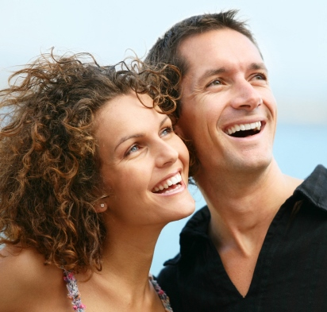
Love Lab
www.enthusiasticlife.net
REACTIONS
Marriage becomes the copy of heavenly family while living the principles of heaven.
There is perpetual desire to explore and develop new dimensions of the marital relationship where pleasure is reciprocated.
There is freedom of expressing the most enjoyable experience and no fear of shame of expressing the pain.

Slide 11
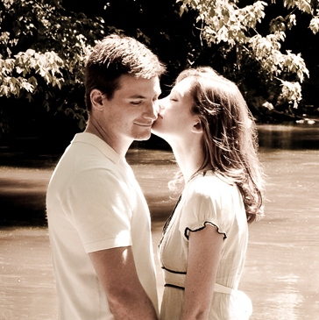
Love Lab
www.enthusiasticlife.net
REACTIONS
With the intention to praise the Creator in every moment of life, as individual and as couple, marriage becomes the perfect social environment for parents and children.
The family becomes “Heaven on Earth”, the place where everybody feels at home, loved, appreciated, respected, cared for, included, and admired. It proves the fact that the Family is a divine establishment. For atheists and post-modernists the family passes the test of time proving that God creates family and He is still in the business of sustaining it.

Slide 12
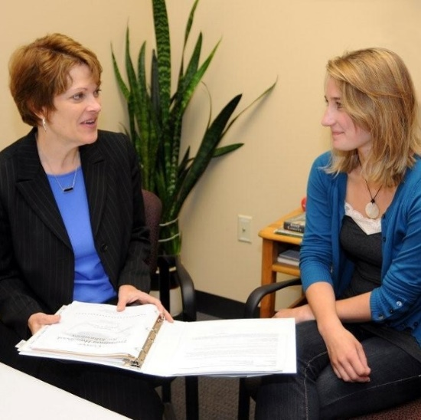
Love Lab
www.enthusiasticlife.net
Let the partners identify the expressions of heroism in the sexual experience and see how these impact their satisfaction.
Explore ways to increase their acts of generosity during sexual experience.
Help them explore their spirituality and see if there are different meanings that could get in the way of fulfilling their desires.
Address the issue of shame and its impact in differentiation.
Explore the value of freedom in relationship.
IMPLICATION FOR PRACTICE
FOR SEX THERAPIST

Slide 13
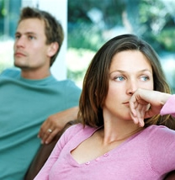
Love Lab
www.enthusiasticlife.net
Explore the meaning of heroism in family.
Look for conditions that favor its expression.
Explore the meaning of generosity in family.
Teach parents how they could help their children in developing it.
Address the meaning of spirituality.
Check if there are different values which could disturb the relationship between partners or between parent and children.
IMPLICATION FOR PRACTICE
family life education specialist

Slide 14

Love Lab
www.enthusiasticlife.net
Show the value of shame for increasing the differentiation level.
Emphasize the importance of intentionality and freedom in relationship.
Provide correct definitions of sin in relationship.
Equip the partners with information regarding loneliness anxiety.
Help them differentiate it from existential loneliness.
Point them to God as the supreme Power and Wisdom and motivate them to stay permanently connected with Him.
IMPLICATION FOR PRACTICE
family life education specialist

Slide 15

Love Lab
www.enthusiasticlife.net
Let the student define the meaning of spirituality.
Help him/her assess his/her capacity for heroism in relationship.
Address the issue of heroism versus risk-taking behaviors.
Correct his misunderstandings regarding heroism.
Help him evaluate ways toward developing skills that will improve his capability to self-preserve him.
Address the issue of generosity in relationship.
IMPLICAȚII PRACTICE
CONSILIERUL ȘCOLAR

Slide 16
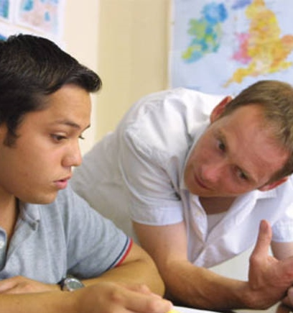
Love Lab
www.enthusiasticlife.net
Equip the student with knowledge regarding the risks related with adaptation that goes against his/her values, just for the sake of maintaining the relationship.
Discuss the concept of intentionality as mandatory for preventing emotional fusion.
Explore the meaning of freedom in relationship.
Let the student explore his/her self-transcendence and encourage him/her to develop an intelligent connection with a God.
IMPLICAȚII PRACTICE
CONSILIERUL ȘCOLAR

Slide 17
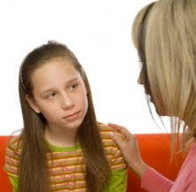
Love Lab
www.enthusiasticlife.net
Prepare the student to deal with loneliness anxiety.
Talk about the concept of sin. Address the issue of shame.
Point him/her toward God as Heavenly Father who loves him/her despite his shortcomings.
Help him/her accept himself/herself as he/she is as an act of being genuine.
IMPLICAȚII PRACTICE
CONSILIERUL ȘCOLAR

Slide 18

Love Lab
www.enthusiasticlife.net
classical author
“Aim for nobility of soul and a pure and unspotted character. Your name may be kept so pure that it cannot justly be connected with anything dishonest or unrighteous but will be respected by all the good and pure, and it may be written in the Lamb's book of life”.
EGW -- MS 4a, 1885. (MM 143, 144.) {1MCP 237.4}

